Slide 1
PROJECT 4A
HBP SPACES
NAME : LIM LAI SIM
MATRIC NO : 103692
COURSE : QUANTITY SURVEYING
ISSUED : 10th August 2009
SUBMITTED : 13th August 2009

Slide 2

I have searched every nook and cranny and finally…

Slide 3

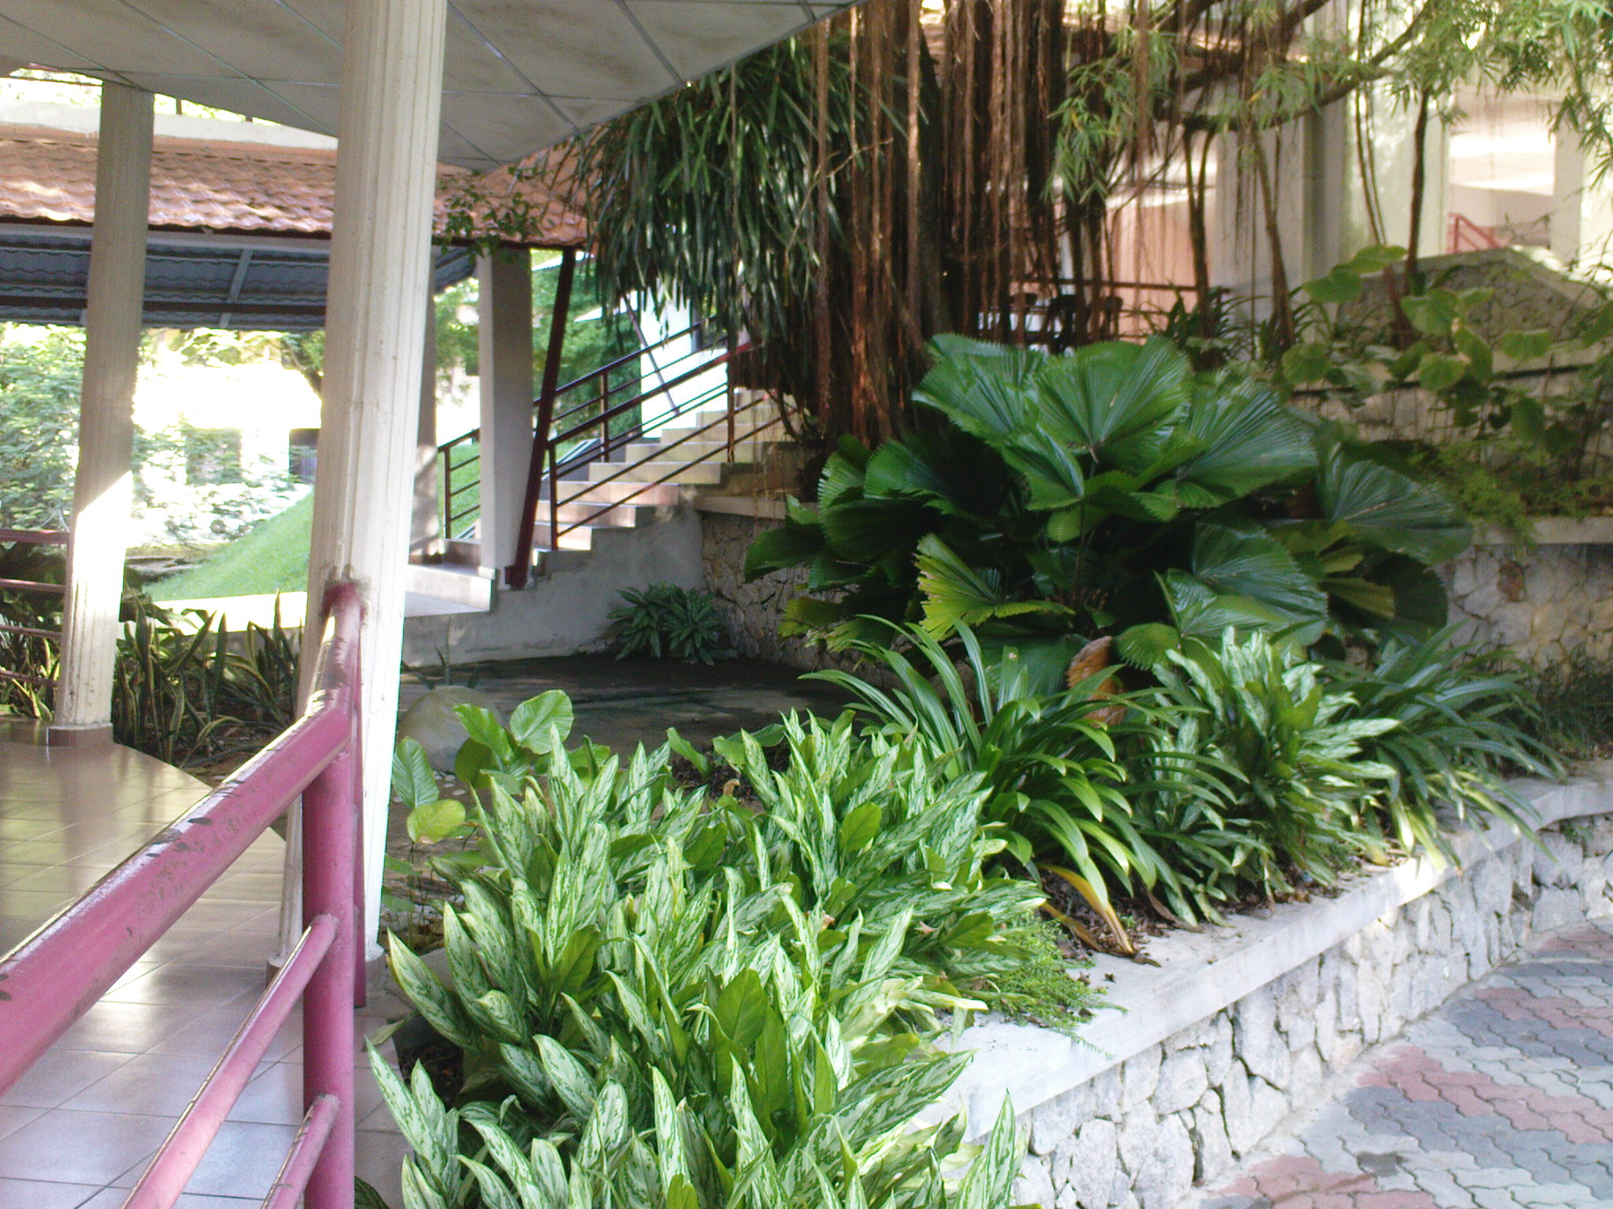
I found it –The space that I was inspired the most

Slide 4
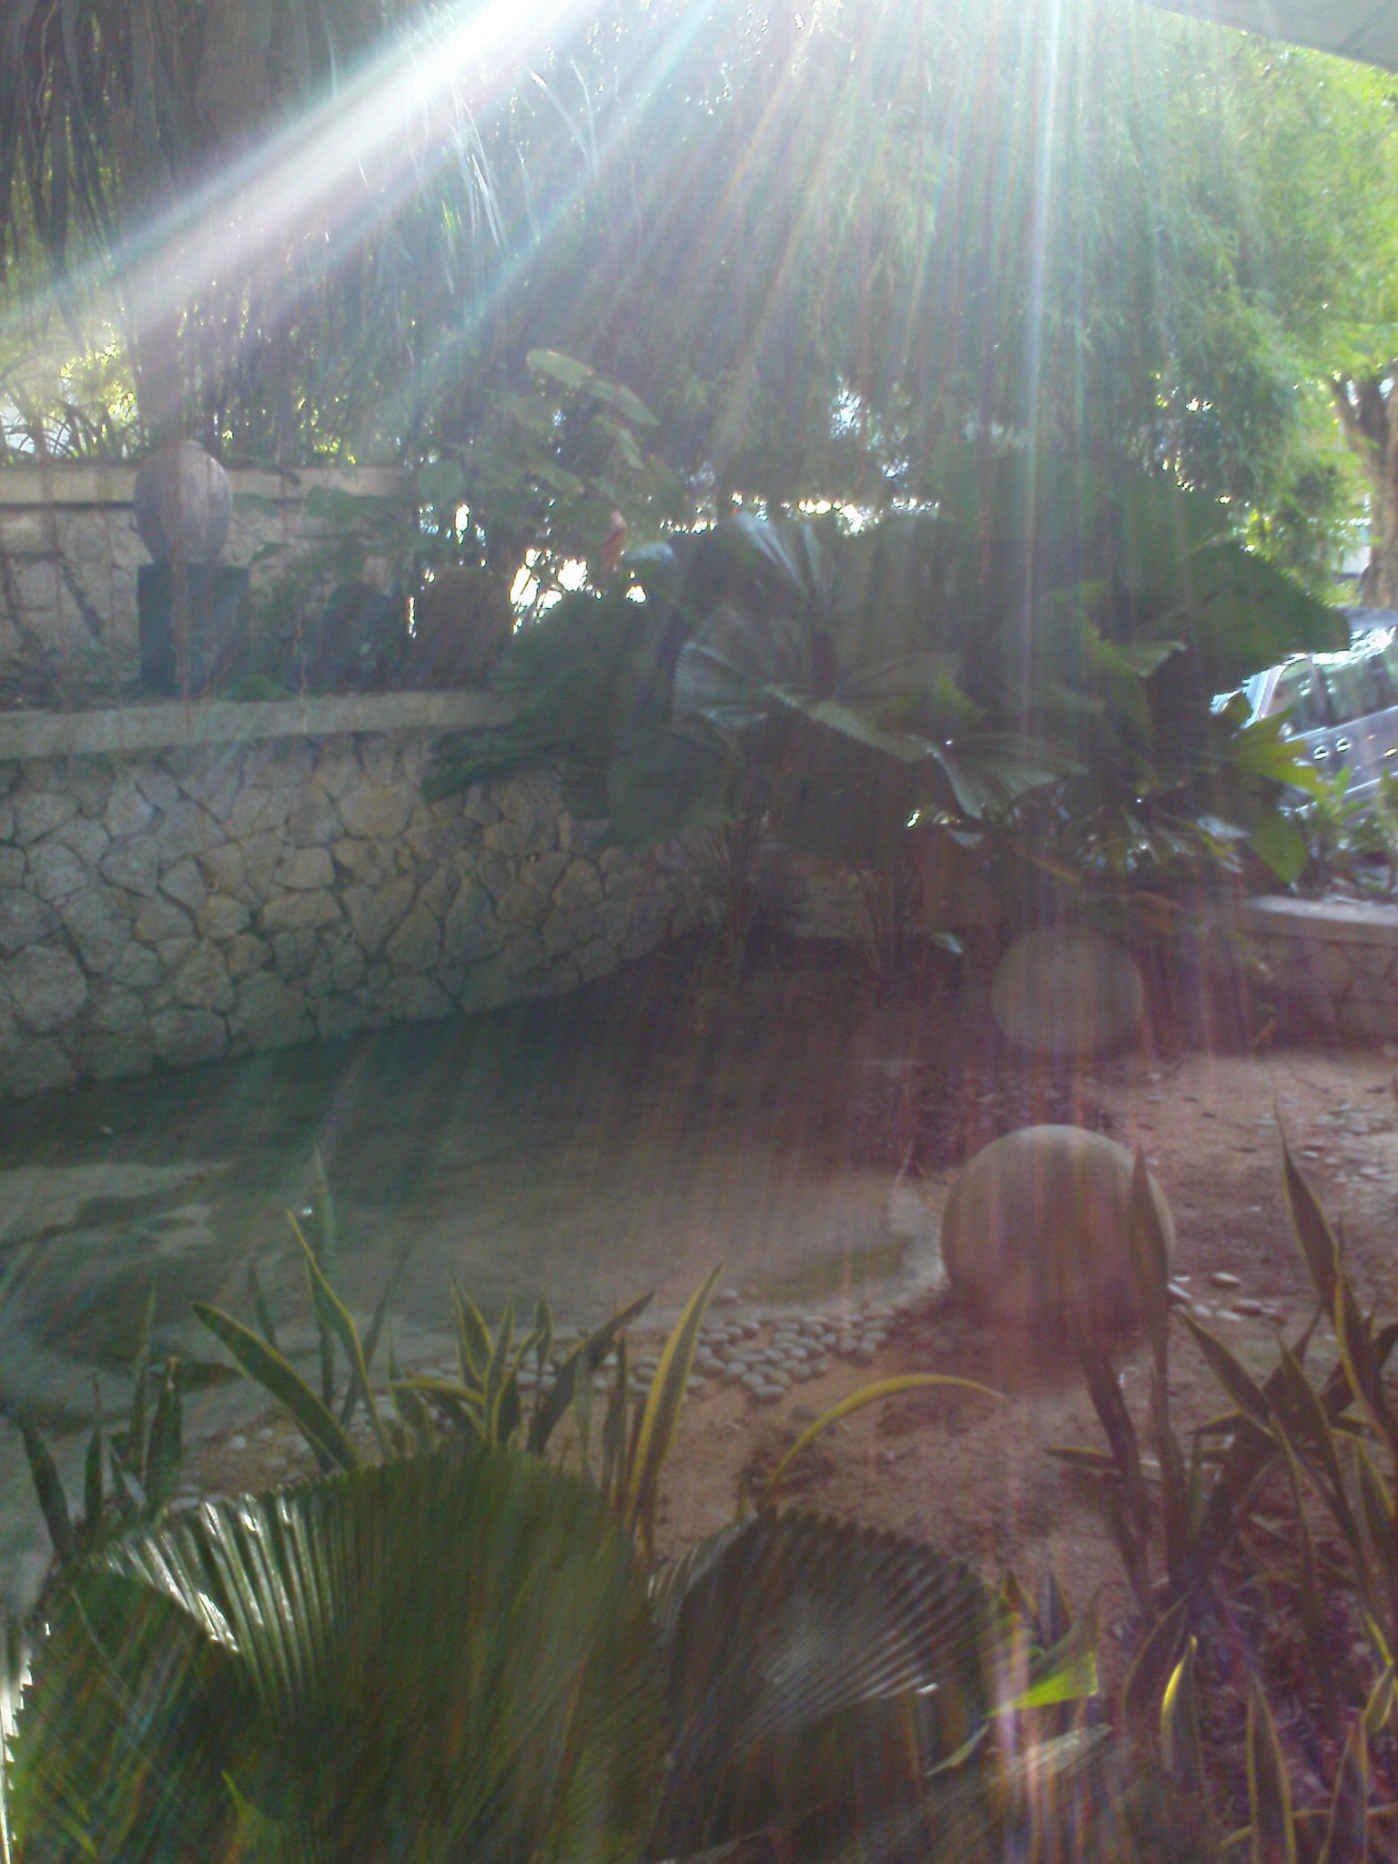
It was here… …

Slide 5


The reasons that I choose the site are :
I was attracted by the green environment. I could see the trees, flowers and rocks around the site.
I could hear the blow of light wind pass through my ears.
The fresh air touched my skin and body tenderly when I was lying on the bamboo mat.
I could feel my body and my mind were relaxing in this comfortable space.
I could smell a little of the essence of sand and plants(maybe because of their wetness).

Slide 6
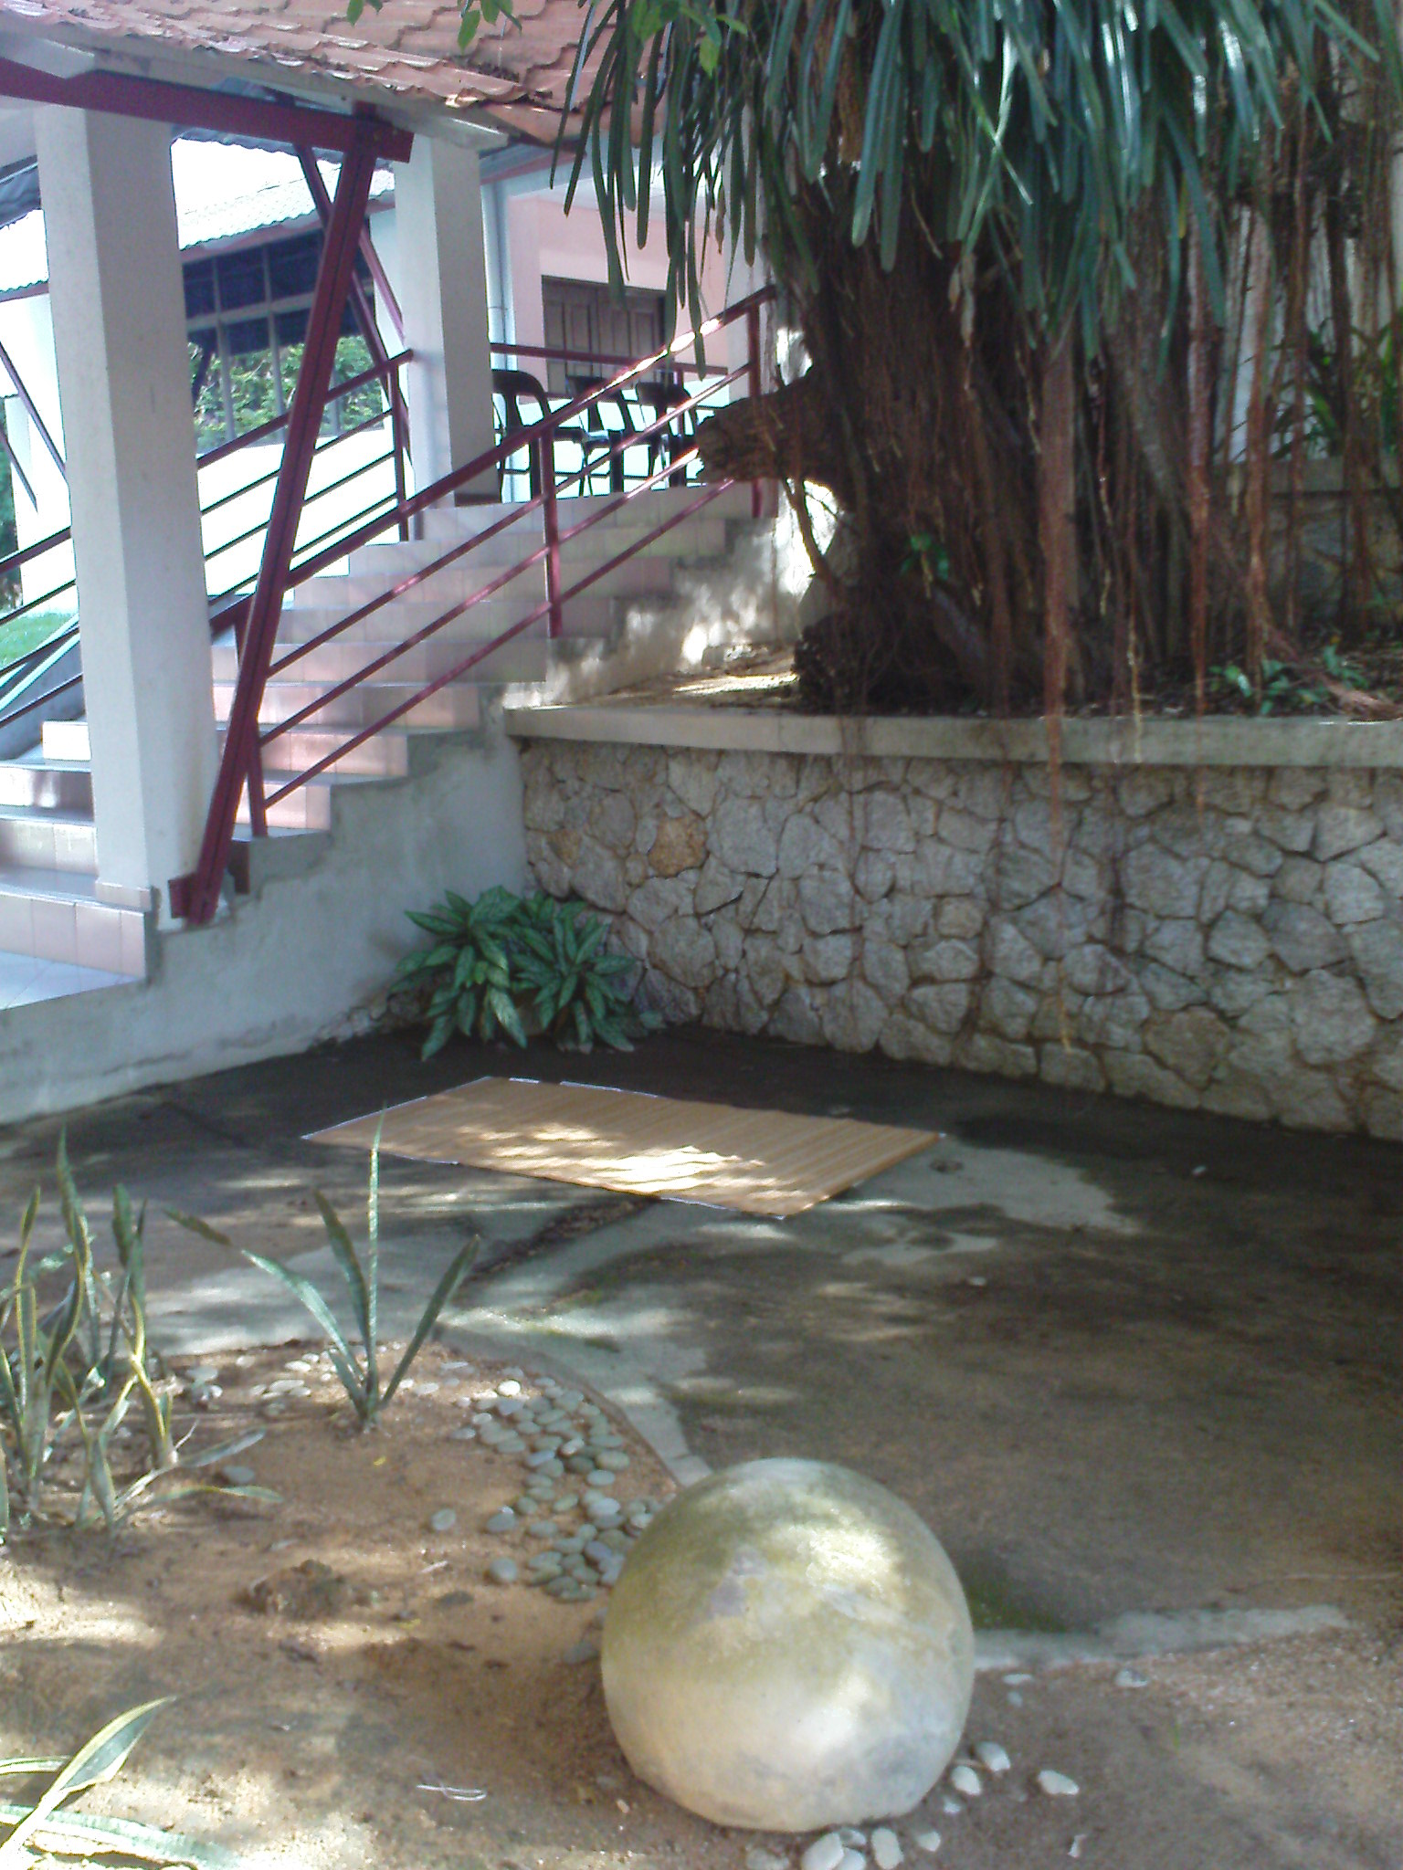
After much considering , I decided to put my bamboo mat under the tree. The big round rock was so fascinating until I couldn’t leave my eyes from it.

Slide 7
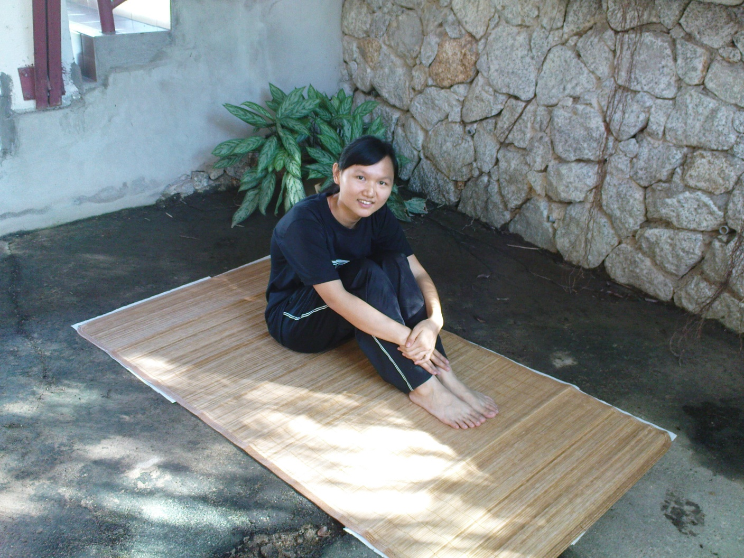
I felt nice to put my feet up and have a break on this natural place.

Slide 8
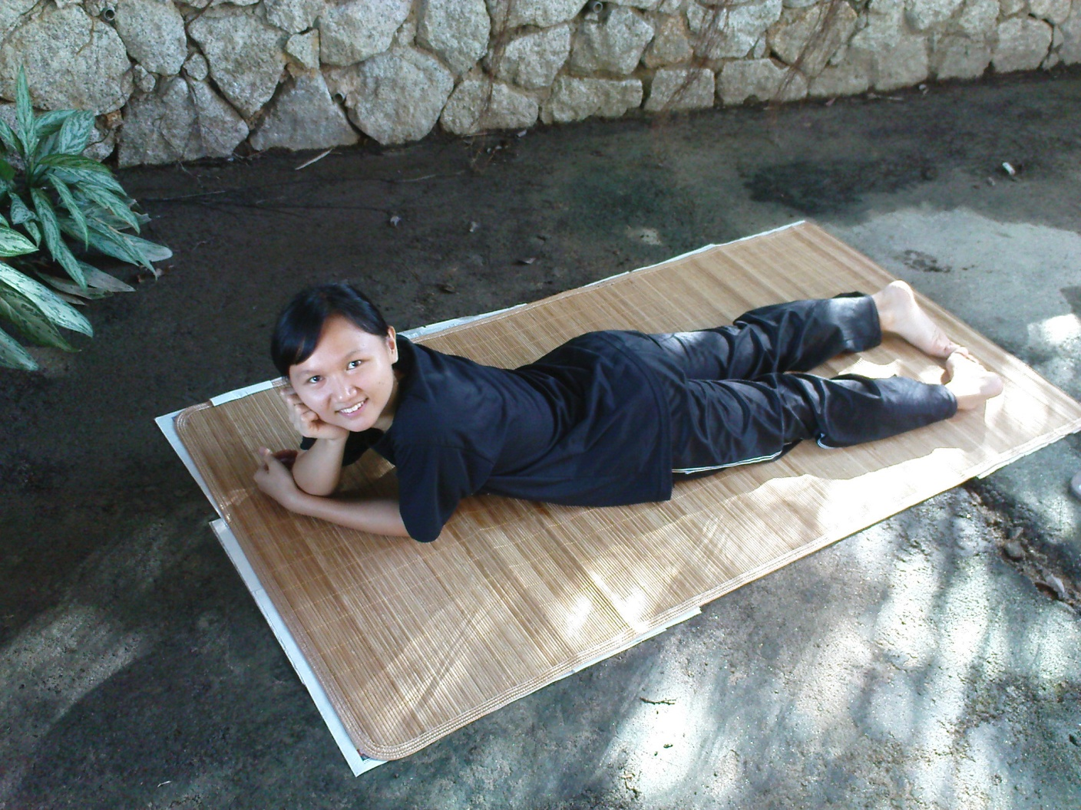
Not bad lying on the bamboo mat although I can feel little hardness of the ground.

Slide 9
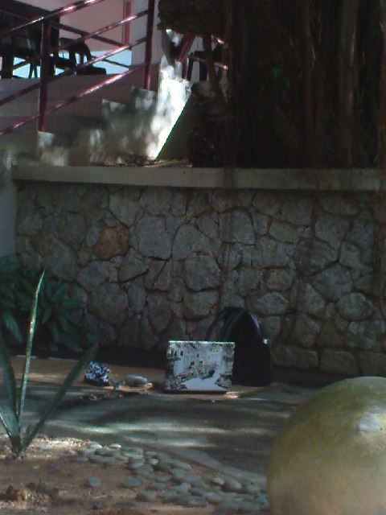
My belongings—always with me especially laptop and glasses.

Slide 10
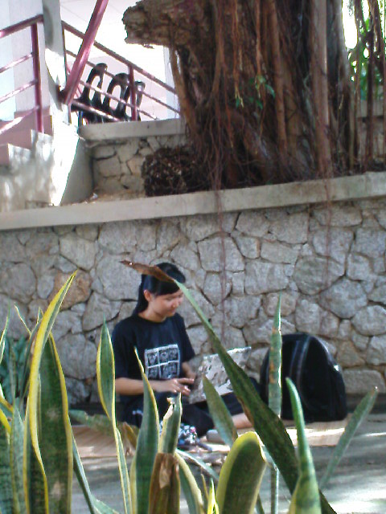
I was sure not doing assignment but playing games.

Slide 11
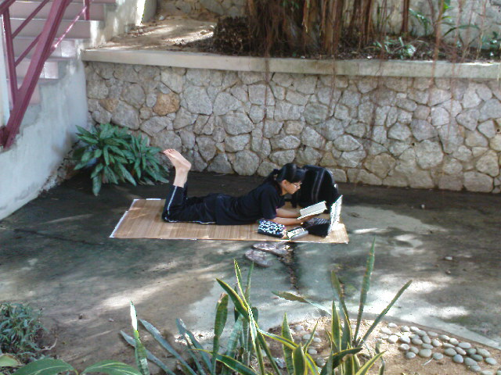
I was reading book.

Slide 12

THE END
THANK YOU

